Slide 1

BUSINESS SKILLS

Slide 2

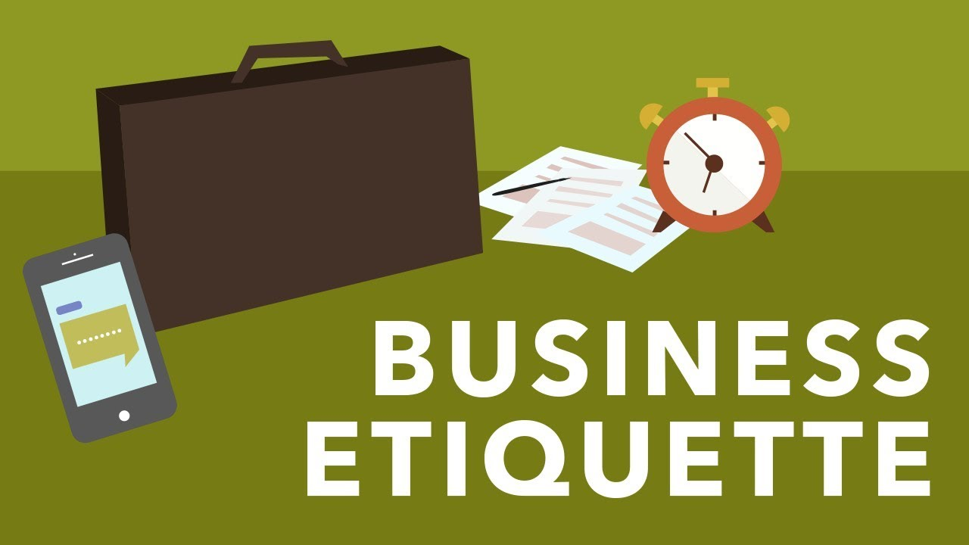
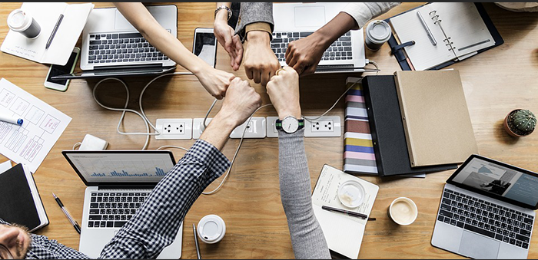
BUSINESS COMMUNICATION
Business Culture
Business Etiquette
Business Correspondence

Slide 3
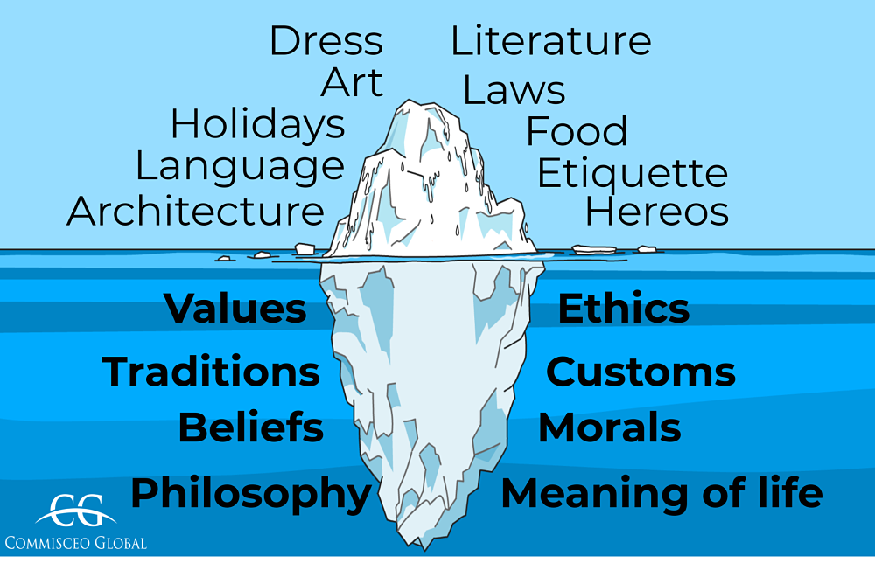
CULTURE

Slide 4
Why To understand Cultural Dimensions?
Culture is the full range of learned human behavior patterns.
Culture is "that complex whole which includes knowledge, belief, art, law, morals, custom, and any other capabilities and habits acquired by man as a member of society.
It is constantly changing and easily lost because it exists only in our minds.

Slide 5
Overall, culture is a fundamental aspect of human existence, shaping individuals' perceptions, values, and behaviors, and contributing to the richness and diversity of the world we live in.

Slide 6
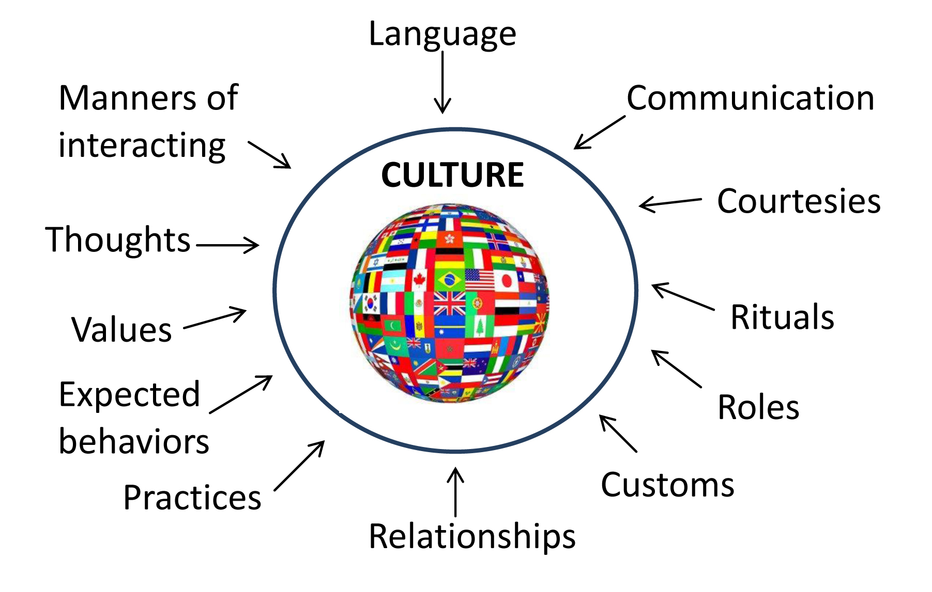
CULTURE

Slide 7
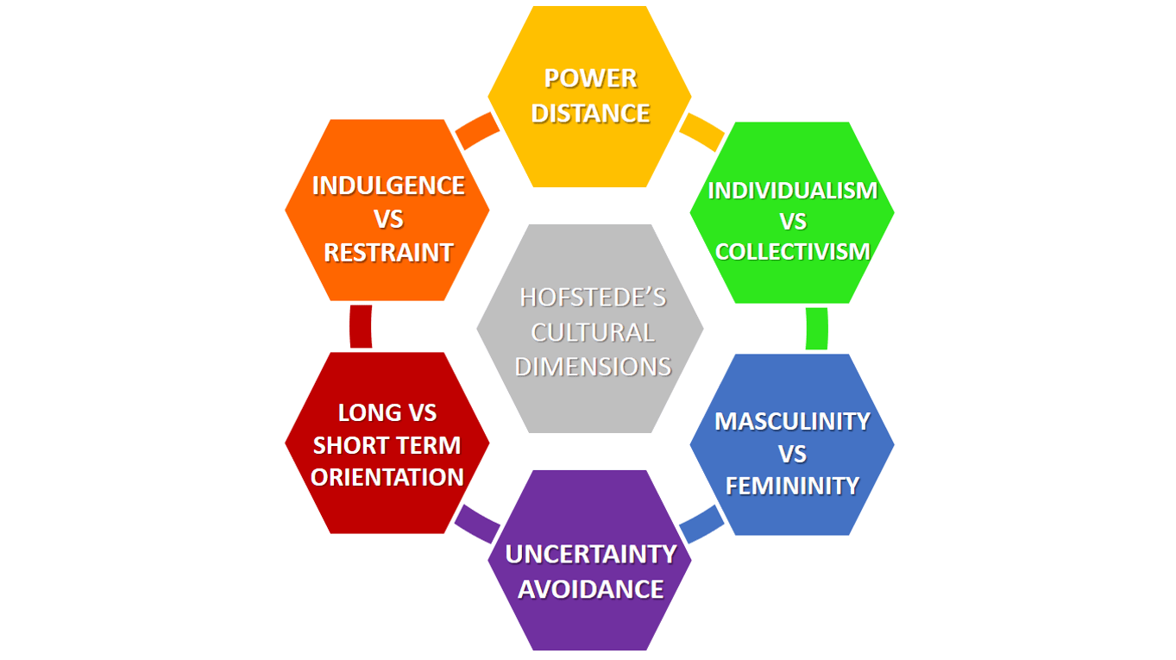
Hofstede’s Cultural dimensions

Slide 8
IDENTITY
UNCERTAINTY
POWER
TIME
GENDER

Slide 9
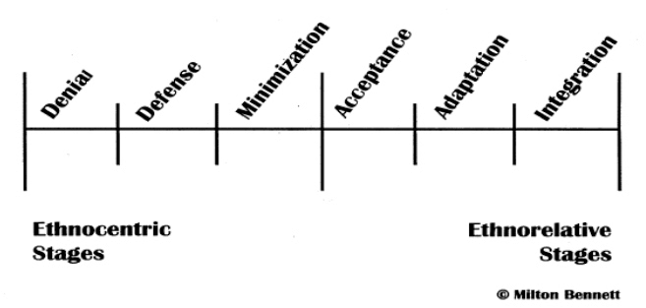
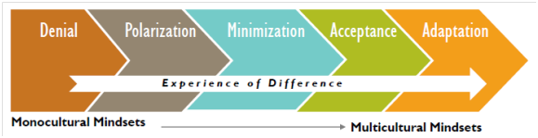
Milton Bennett

Slide 10

Case Study

Slide 11

The company's "20% time" policy allows employees to spend a portion of their working hours on personal projects, fostering a culture of experimentation and creativity.

Slide 12
"TGIF" (Thank God It's Friday) meetings, facilitate cross-functional collaboration and knowledge sharing.

Slide 13
The company provides on-site gyms, recreational facilities, flexible working hours, and other benefits to promote employee well-being and overall satisfaction.

Slide 14
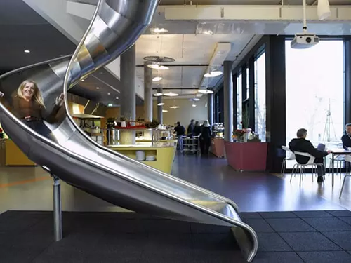

Slide 15
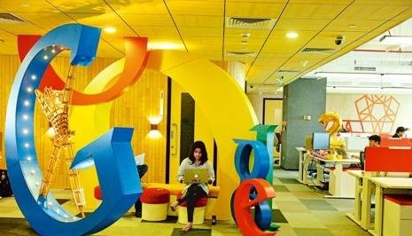

Slide 16


Slide 17

Tata Group also encourages a culture of continuous learning and innovation among its employees.

Slide 18
The Tata Group has a deep-rooted culture of social responsibility.

Slide 19
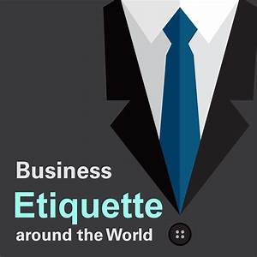
BUSINESS ETIQUETTE

Slide 20
What is Business Etiquette?
The code of ethical behavior regarding professional
practice or action among the members of a profession
in their dealings with each other.

Slide 21
Case Study

Slide 22
Business Etiquette in a Global Conference
You are an executive from a multinational technology company, TechGen, attending a global conference focused on emerging technologies, innovation, and networking. The conference is being held in a major city and will last for three days. Participants include representatives from various industries, including technology, finance, healthcare, and more. Your goal is to make valuable connections, showcase TechGen's latest advancements, and potentially strike partnership deals.

Slide 23
Challenges:
1. The conference participants come from diverse cultural backgrounds, and each culture might have its own expectations and norms when it comes to business interactions and communication.

Slide 24
2. The conference includes breakfasts, lunches, and dinners, where participants can mingle in a more relaxed setting. You're unsure about how to balance casual conversation with business discussions during these mealtime interactions.

Slide 25
Adaptability
The Approach
Active Listening
Audience Analysis
Balanced Conversations
Respect Privacy

Slide 26

Attire management

Slide 27
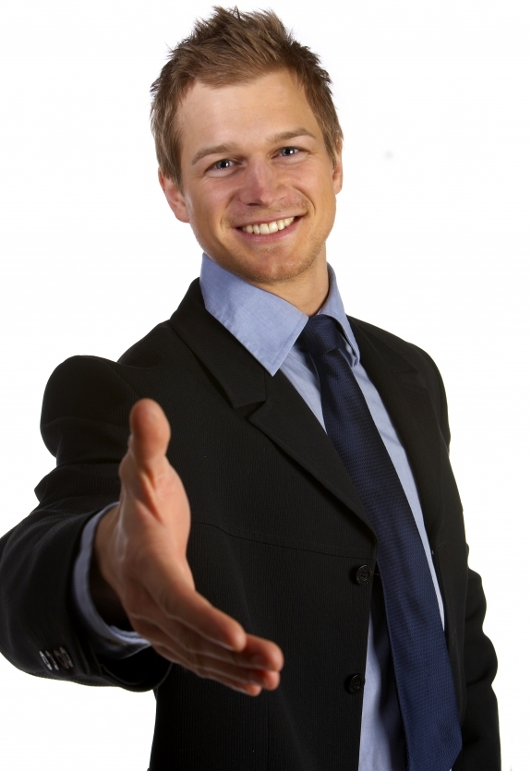
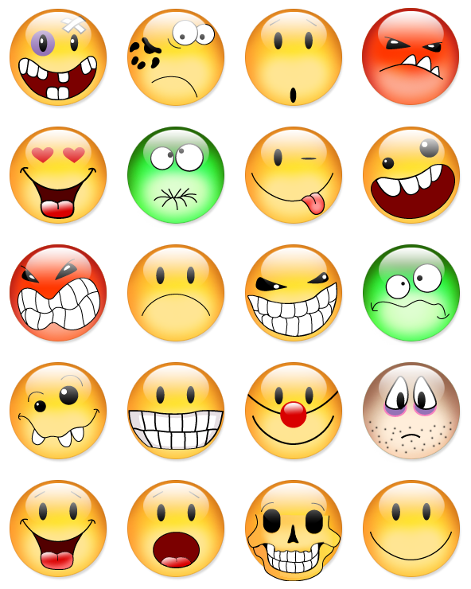
First Impression
Smile please
Dress Well
Use a right formal combination
Be proactive
make your style
Be humble

Slide 28

VIDEO

Slide 29
RULE OF 12
The first twelve inches from the shoulders up
The first twelve steps a person takes
The first twelve words a person states

Slide 30
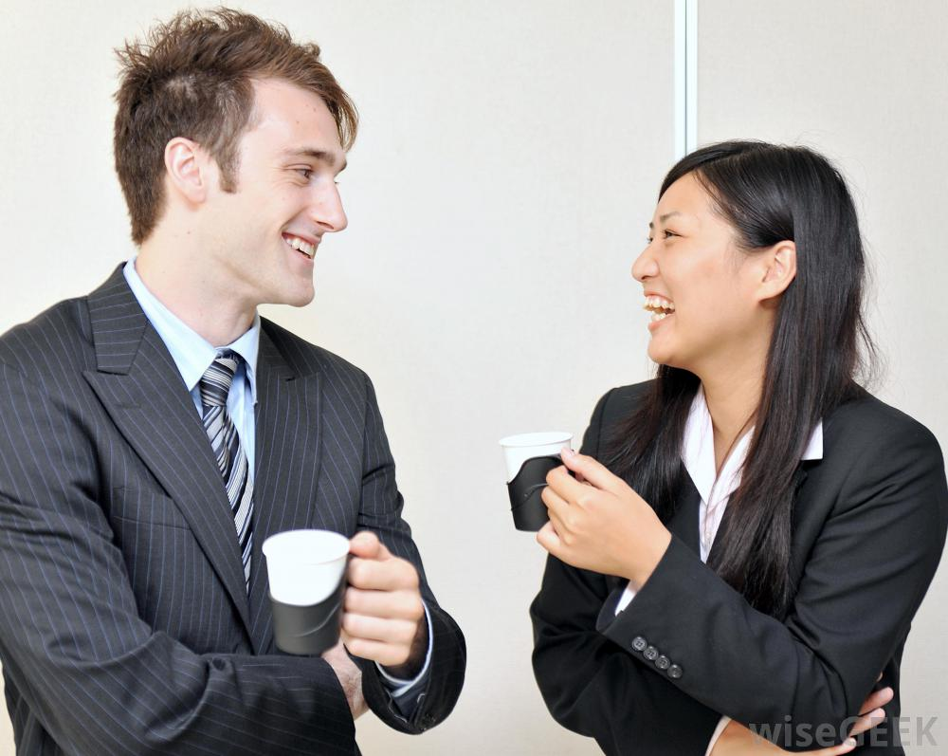
First Talk
Small Talk
Impromptu
Elevator talk

Slide 31
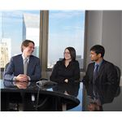
Office Etiquette
Power of greeting
Power of acknowledgement
Power of smile
Power of courtesy
Privacy is the key
Gossip is dangerous

Slide 32
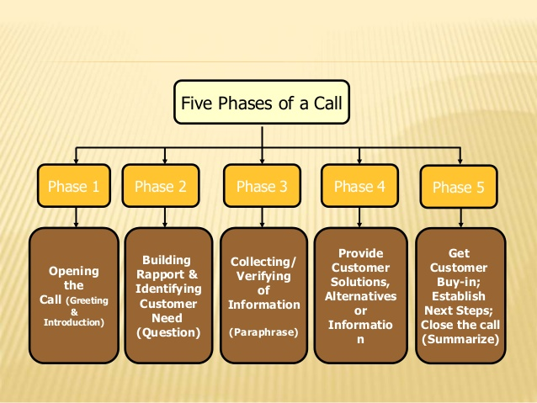
Telephone Etiquette

Slide 33
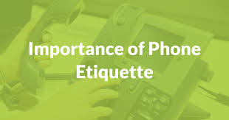
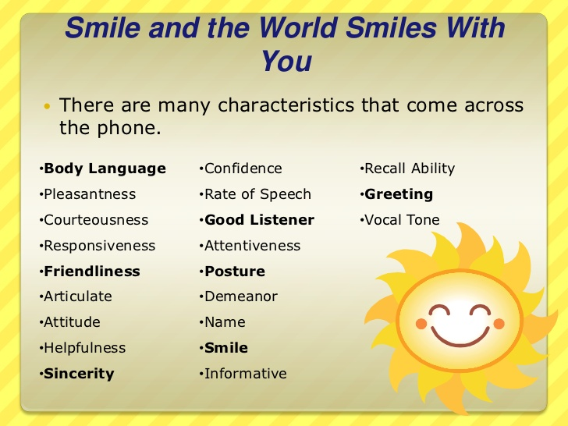
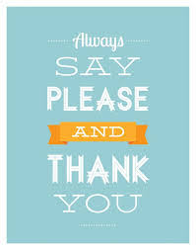
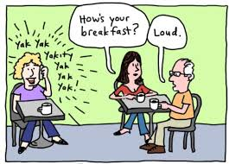
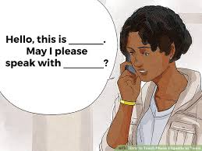

Slide 34
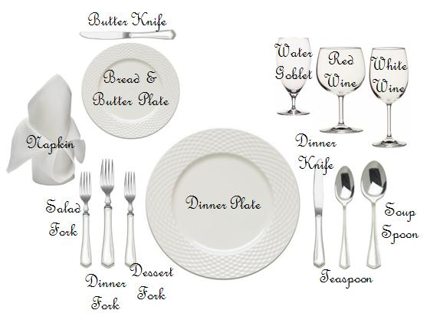
DINNING ETIQUETTE

Slide 35
Some Tips on Dinning Etiquette

Slide 36
The host should always be in charge

Slide 37
Touching all of the food

Slide 38
Keep the food options balanced with your guest

Slide 39
Do not use the napkin as a tissue

Slide 40
Know the "rest" and "finished" positions

Slide 41
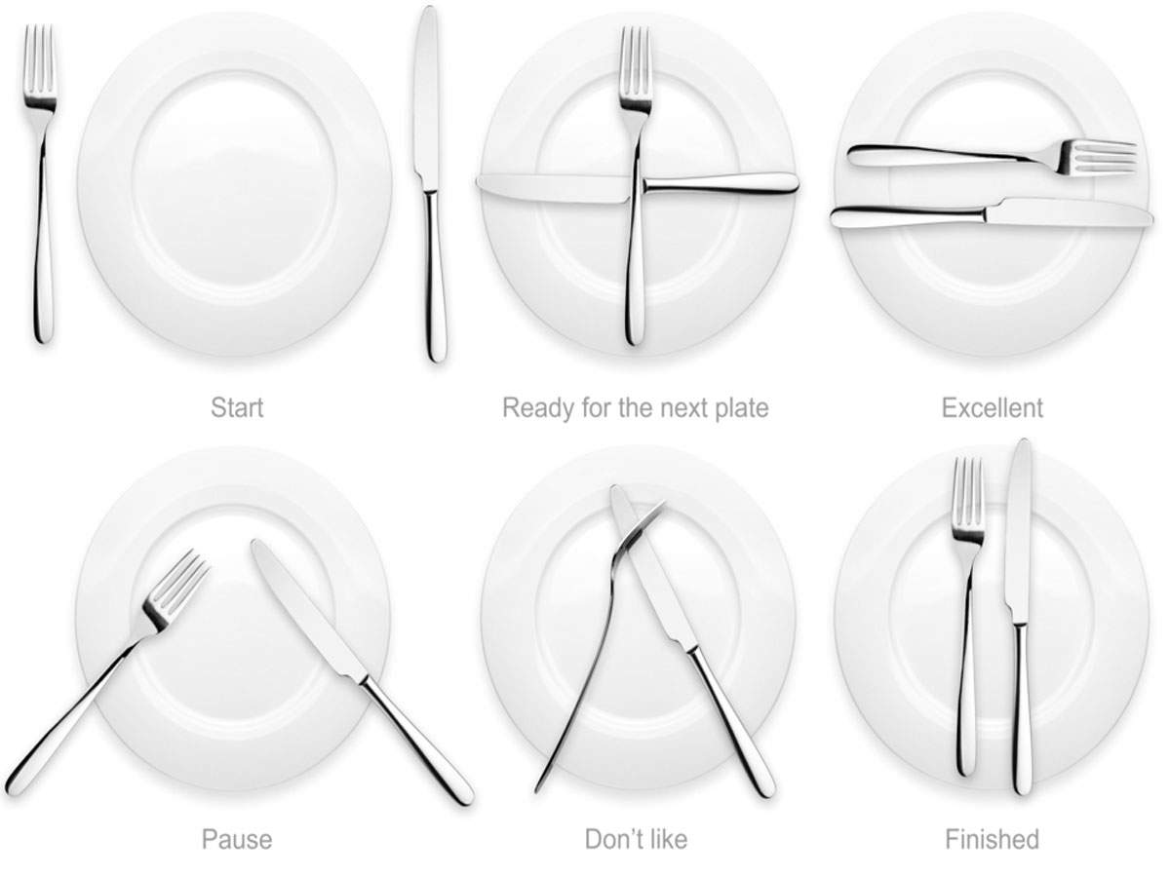

Slide 42
The host should always be in charge

Slide 43
Cutting Your Food into Bite-Sized Pieces all at Once

Slide 44
No Phones at Dinner

Slide 45
Chewing with you mouth open

Slide 46
Being rude to the waiter

Slide 47
Keep the tip for the waiter ( 10 %)

Slide 48
Here are six conversation topics you should avoid at the dinner table:
Relationship status.
Never ask someone about their relationship status at the dinner table. ...
Health & Appearance. Health and appearance are also topics that should be avoided. ...
Plan for having children. ...
Politics. ...
Religion. ...
Personal Finances.

Slide 49
Do not lean forward for the food

Slide 50
Stay seated and sit up straight.

Slide 51
The host should always pay

Slide 52
Sending the thank you note to the host

Slide 53
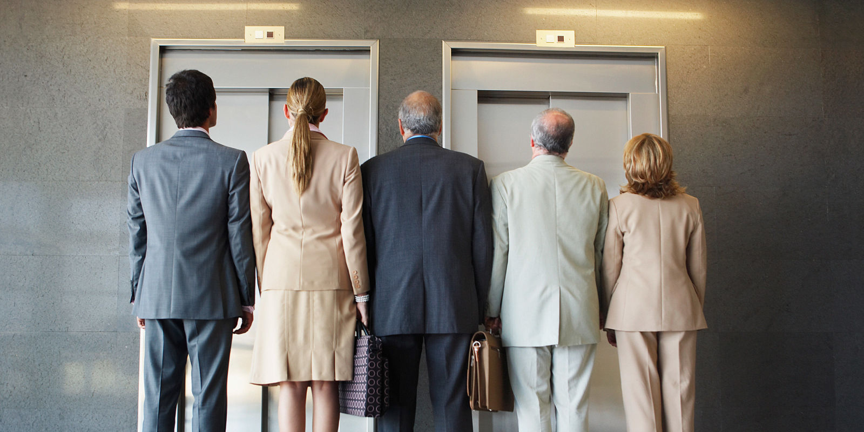
Elevator Etiquette

Slide 54
1. Hold the door for the person behind you
2.Pay Attention to Elevator Direction
3.Use Common Sense When Pressing Buttons
4. Protect Personal Space
5. Make Way for Others to Exit as Needed

Slide 55
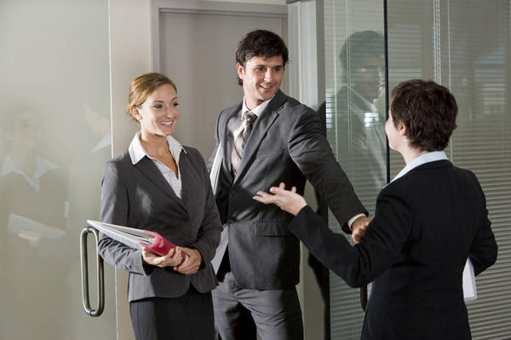
Door Etiquette

Slide 56
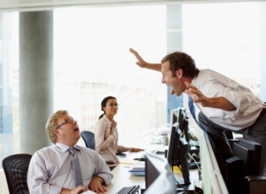
Cubical Etiquette

